Slide 1

Project 1
Card Game
GUESS WHO
By Paola Dumbi & Harin Pulkaram

Slide 2
INTRODUCTION
Cultural Card Game
Theme: Black History Month
Goal: Player sees a pictures of important African American figures; the player has to recognize the figure whose name and description is found on the back of the card.

Slide 3
DEMO
https://codd.cs.gsu.edu/~rdumbi2/WebProgramming/Projects/Project1/guesswho.html

Slide 4
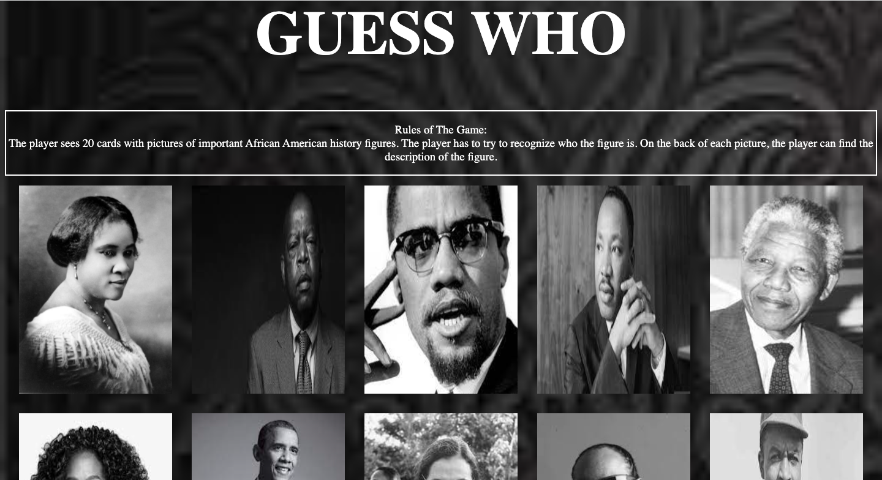
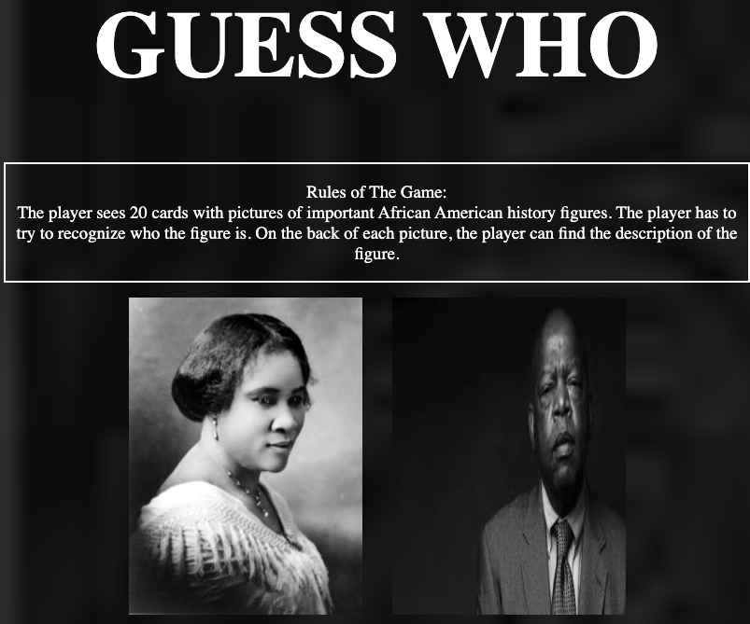
Notes:
We wanted the content of our page to be able to adjust to the dimension of the page. So, we used a section tag with the display:flex property. We also aligned and justify the content of the tag.

Slide 5
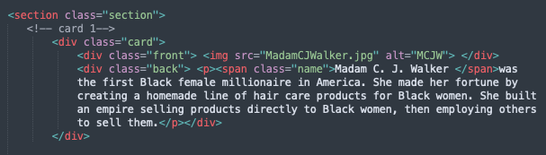

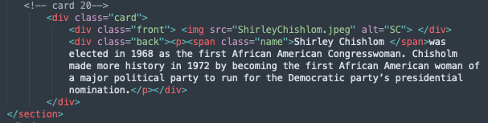
HTML
CSS

Slide 6
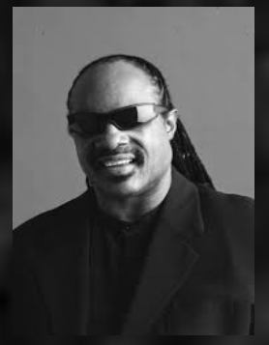
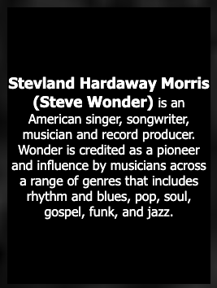
CARDS

Slide 7
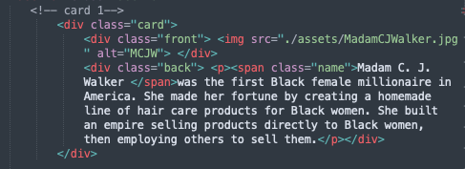
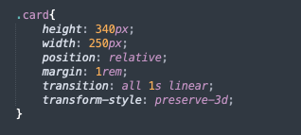
HTML CSS
CARD
Notes:
Relative to their normal position
Preserve 3d allows to see the back of the card when it turn and see the picture only

Slide 8
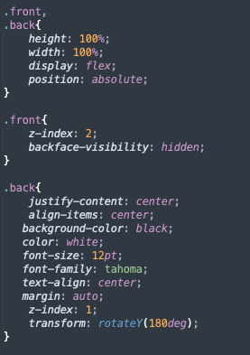
HTML CSS
CARD
Notes:
The z-indexes will allow us to overlap the front and the back of the card
The transform attribute allows us to rotate the cards
Backface-visibility: hidden; whether or not the back face of an element should be visible when facing the user

Slide 9
THANK YOU!

